Slide 1
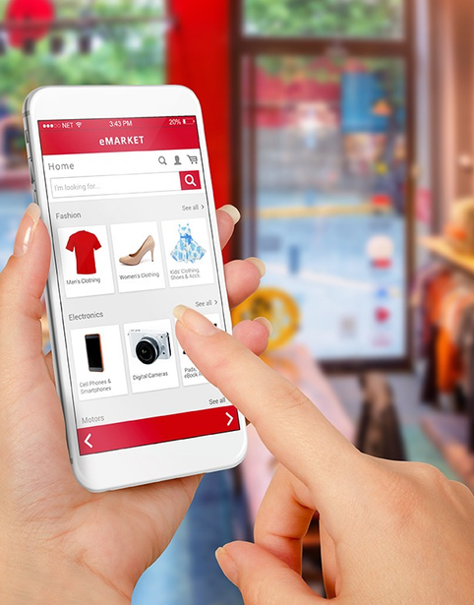


Ecommerce in Nepal
PRESENTAION ON
E-COMMERCE IN NEPAL
By: Aashish Subedi

Slide 2

E-commerce in Nepal
Introduction
E-commerce is the modern way of shopping—buying and selling products online anytime, anywhere. It brings convenience, variety, and great deals right to your fingertips!"

Slide 3

E-commerce in Nepal
Advantages of E-commerce
Convenience: Customers can shop anytime and from anywhere.
Wider Product Variety: E-commerce provides access to a large range of products in one place.
Lower Prices: Online stores often offer better prices due to lower operating costs.

Slide 4

E-commerce in Nepal
Disadvantages of E-commerce
Lack of Physical Inspection: Customers cannot touch or test products before buying.
Security & Privacy Risks: Online transactions may be vulnerable to fraud or data breaches.
Dependency on Internet & Technology: Poor connectivity or technical issues can interrupt shopping or transactions.

Slide 5



E-commerce in Nepal
Types of E-commerce
B2C (Business to Consumer): Businesses sell products or services directly to customers.
B2B (Business to Business): Businesses sell to other businesses.
C2C (Consumer to Consumer): Consumers sell products or services to other consumers through online platforms.
C2B (Consumer to Business): Individuals offer products or services to businesses (e.g., freelancers, influencers).

Slide 6

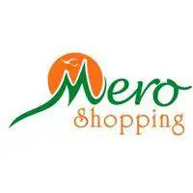

E-commerce in Nepal
Daraz Nepal:The largest online marketplace offering a wide range of products with regular sales and multiple payment options.
HamroBazar:
A popular platform for buying and selling new and second-hand items, including electronics, vehicles, and real estate.

Slide 7
E-commerce in Nepal
MeroShopping –
An online store providing electronics, fashion, and daily-use products with reliable delivery services.
Foodmandu:
Foodmandu is Nepal’s first online food delivery service. It delivers meals and groceries from various restaurants across major cities.

Slide 8
E-commerce in Nepal
Thank You For Attention
Aashish Subedi

